Slide 1
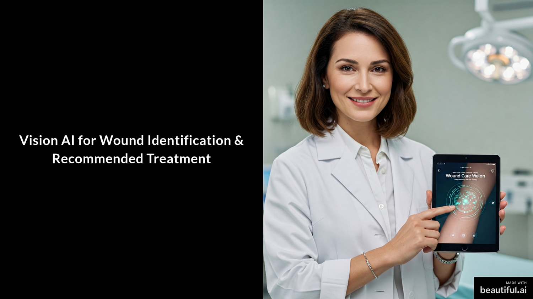

Slide 2
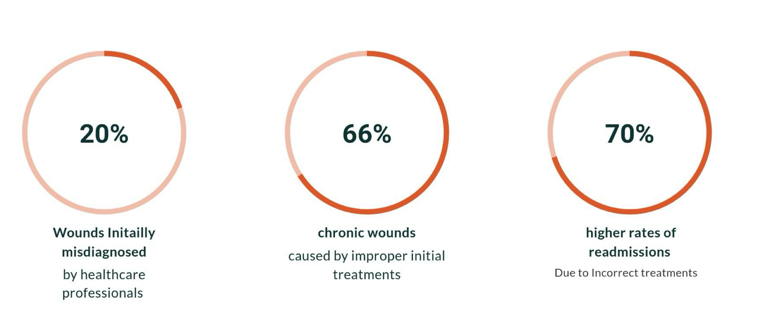
Wound Misidentification

Slide 3
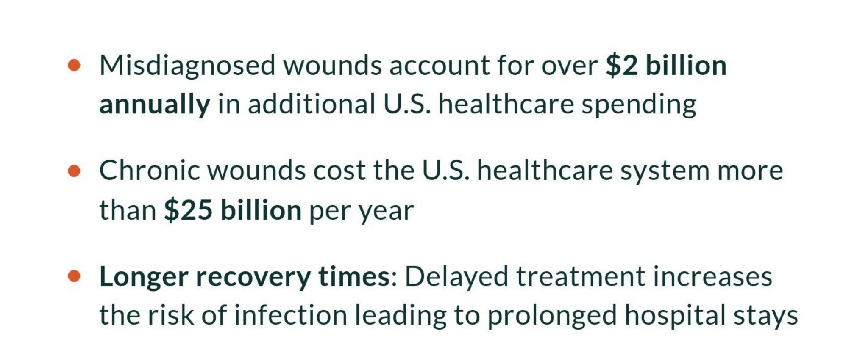
Cost of Misdiagnosis and Mistreatment

Slide 4
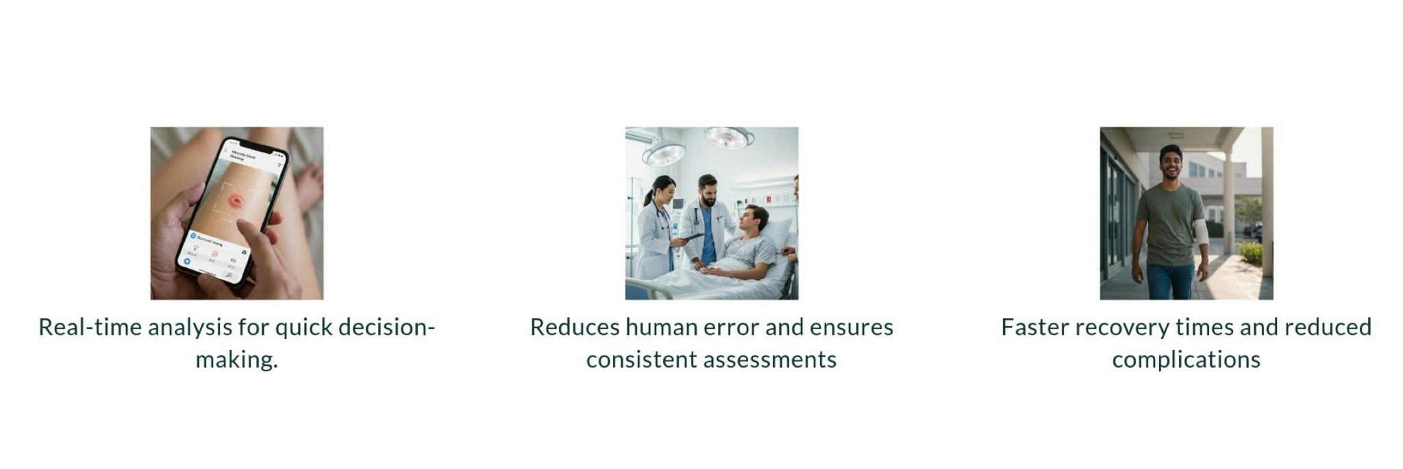
Impact & Benefits

Slide 5
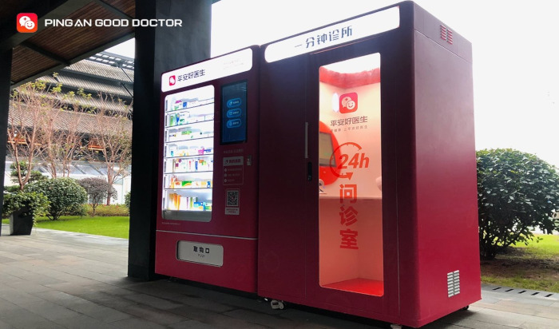
Competitor & Real World
"Ping An Good Doctor already has a platform and a booth in China."

Slide 6
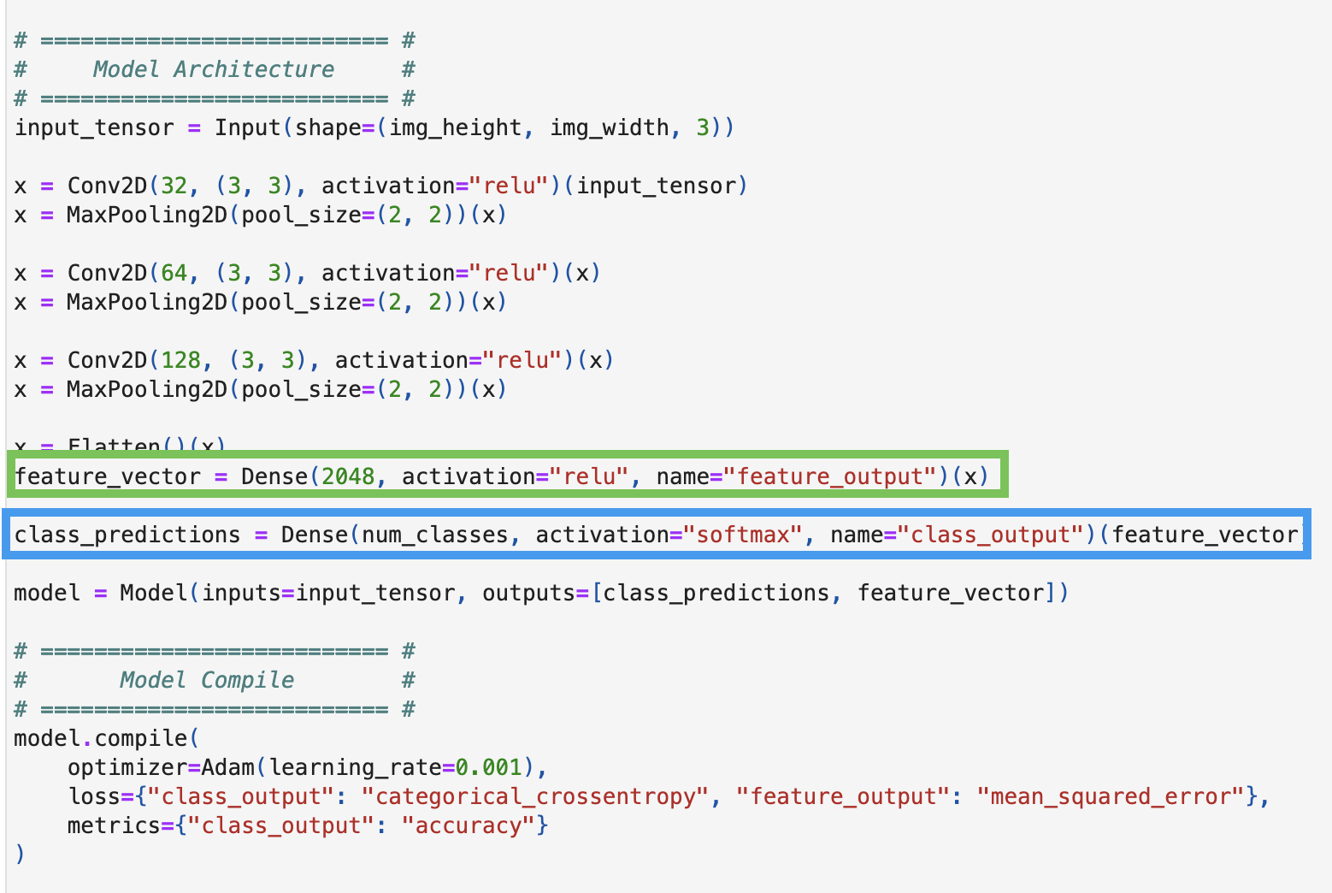
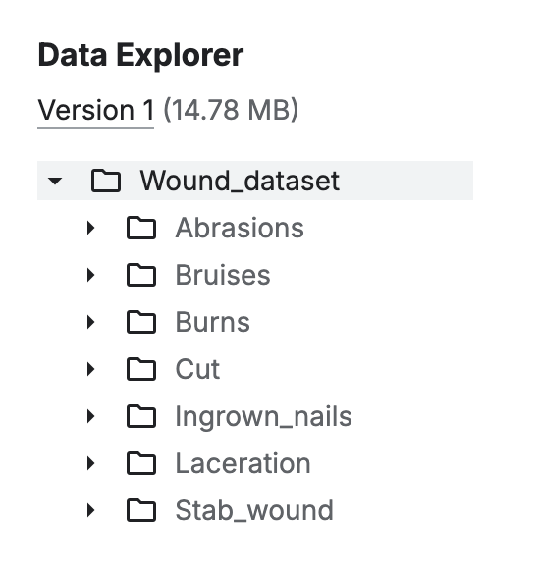
Train Data and Model
From Kaggle
Total: 2940 Images

Slide 7
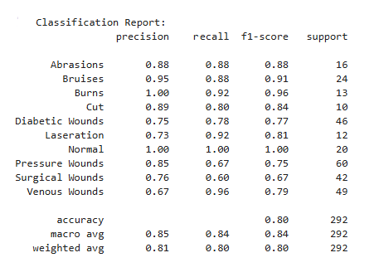
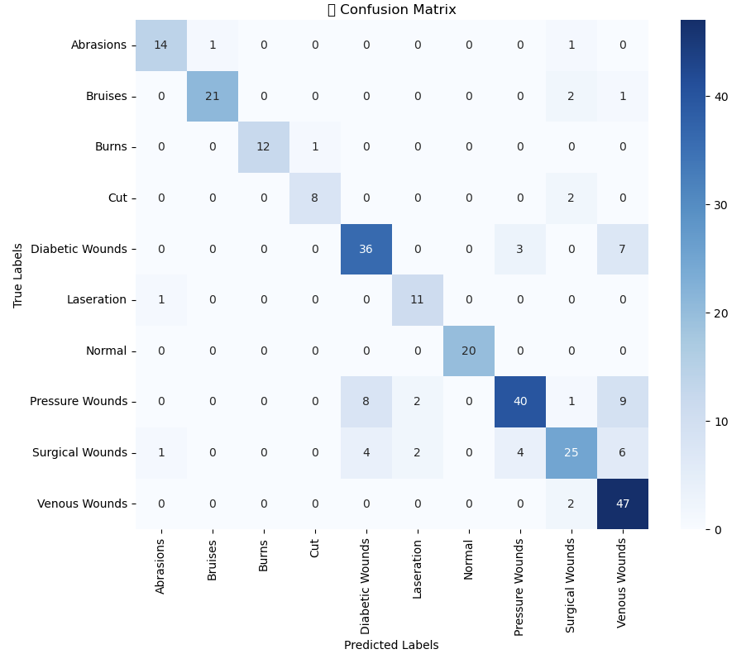
Prediction Result

Slide 8
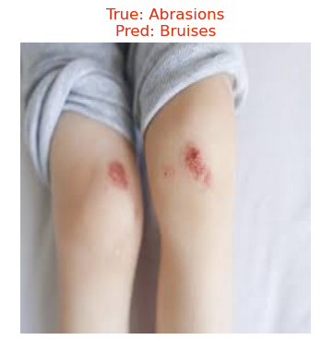
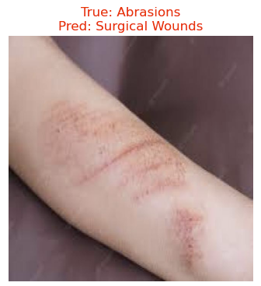
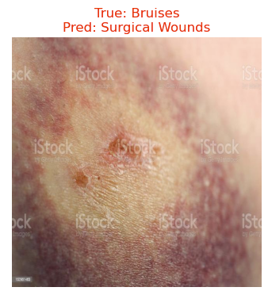
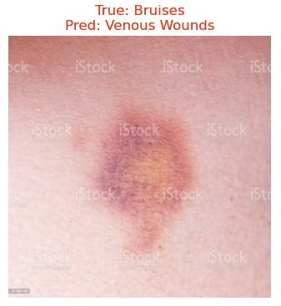
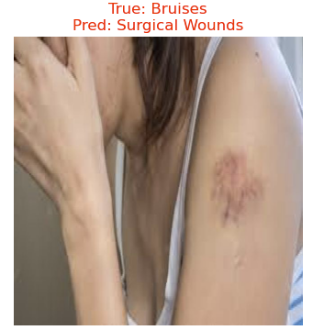
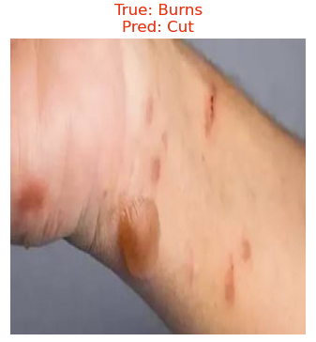
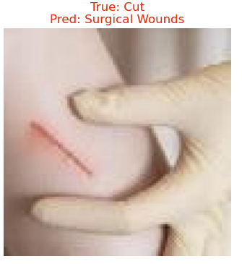
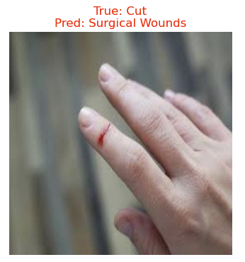
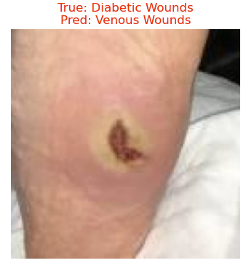
Prediction Result

Slide 9
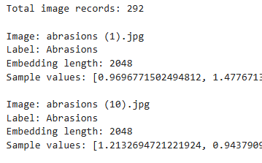
Vector Embedding & Mongodb Connection
Step-1
Step 2
Step 3
Image Preprocessing and Feature Extraction:
Resize to 224x224 pixels to match the input size of ResNet50.
Normalize the image
ResNet50 model (without the top classification layer).
Extract a 2048-dimensional feature vector (embedding) that represents high-level features of the image.
Saving the Embeddings and Metadata:
Generate Embeddings
Store Metadata:
Extract the label from the directory structure.
Pair the image name and label with the embedding vector.
Save to JSON
Push Data to MongoDB

Slide 10
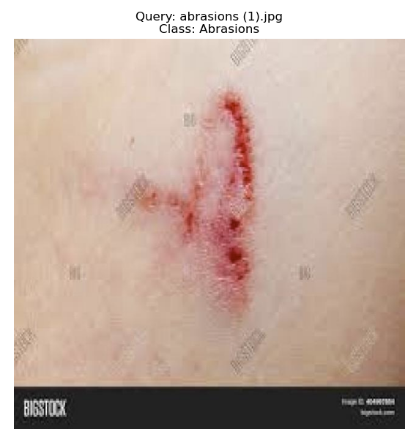
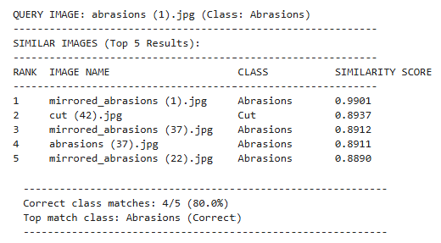
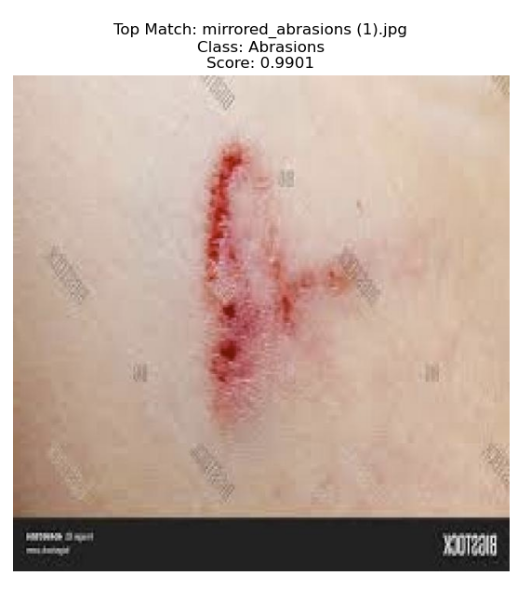
Vector Search Result

Slide 11
Conclusion:
The combination of CNN for classification and Vector Search for storing embeddings enables scalable and efficient wound assessment. This solution ensures fast, accurate classification, aiding quick treatment decisions in critical or remote care settings.
Future works:
We plan to expand the dataset with images of wounds at different healing stages, allowing healthcare professionals to track recovery progress and improve treatment decisions, leading to better patient outcomes.

